Slide 1
Herd Prototyping
Dartis Willis
Cristian Lara
Neven Wang -Tomic

Slide 2

Overview

Slide 3
“Never miss out!”
Enabling people to make informed decisions using
reliable user-driven data.

Slide 4
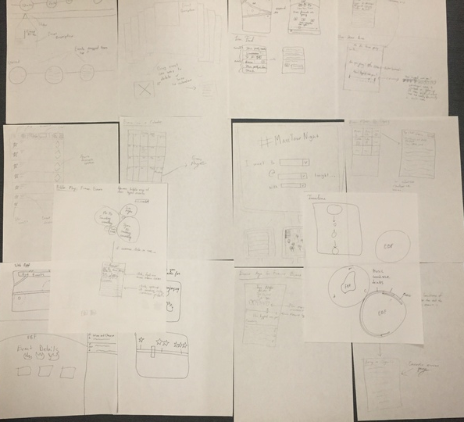
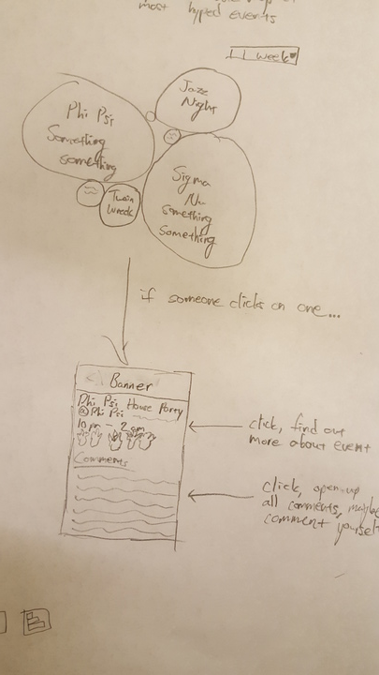
Selected Interface
Criteria
Compact/Efficient
Aesthetic
Novel
Simple @ Surface Level

Slide 5
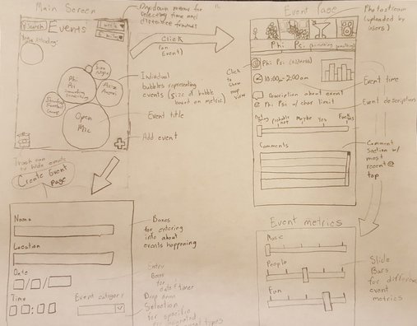
Prototype layout

Slide 6
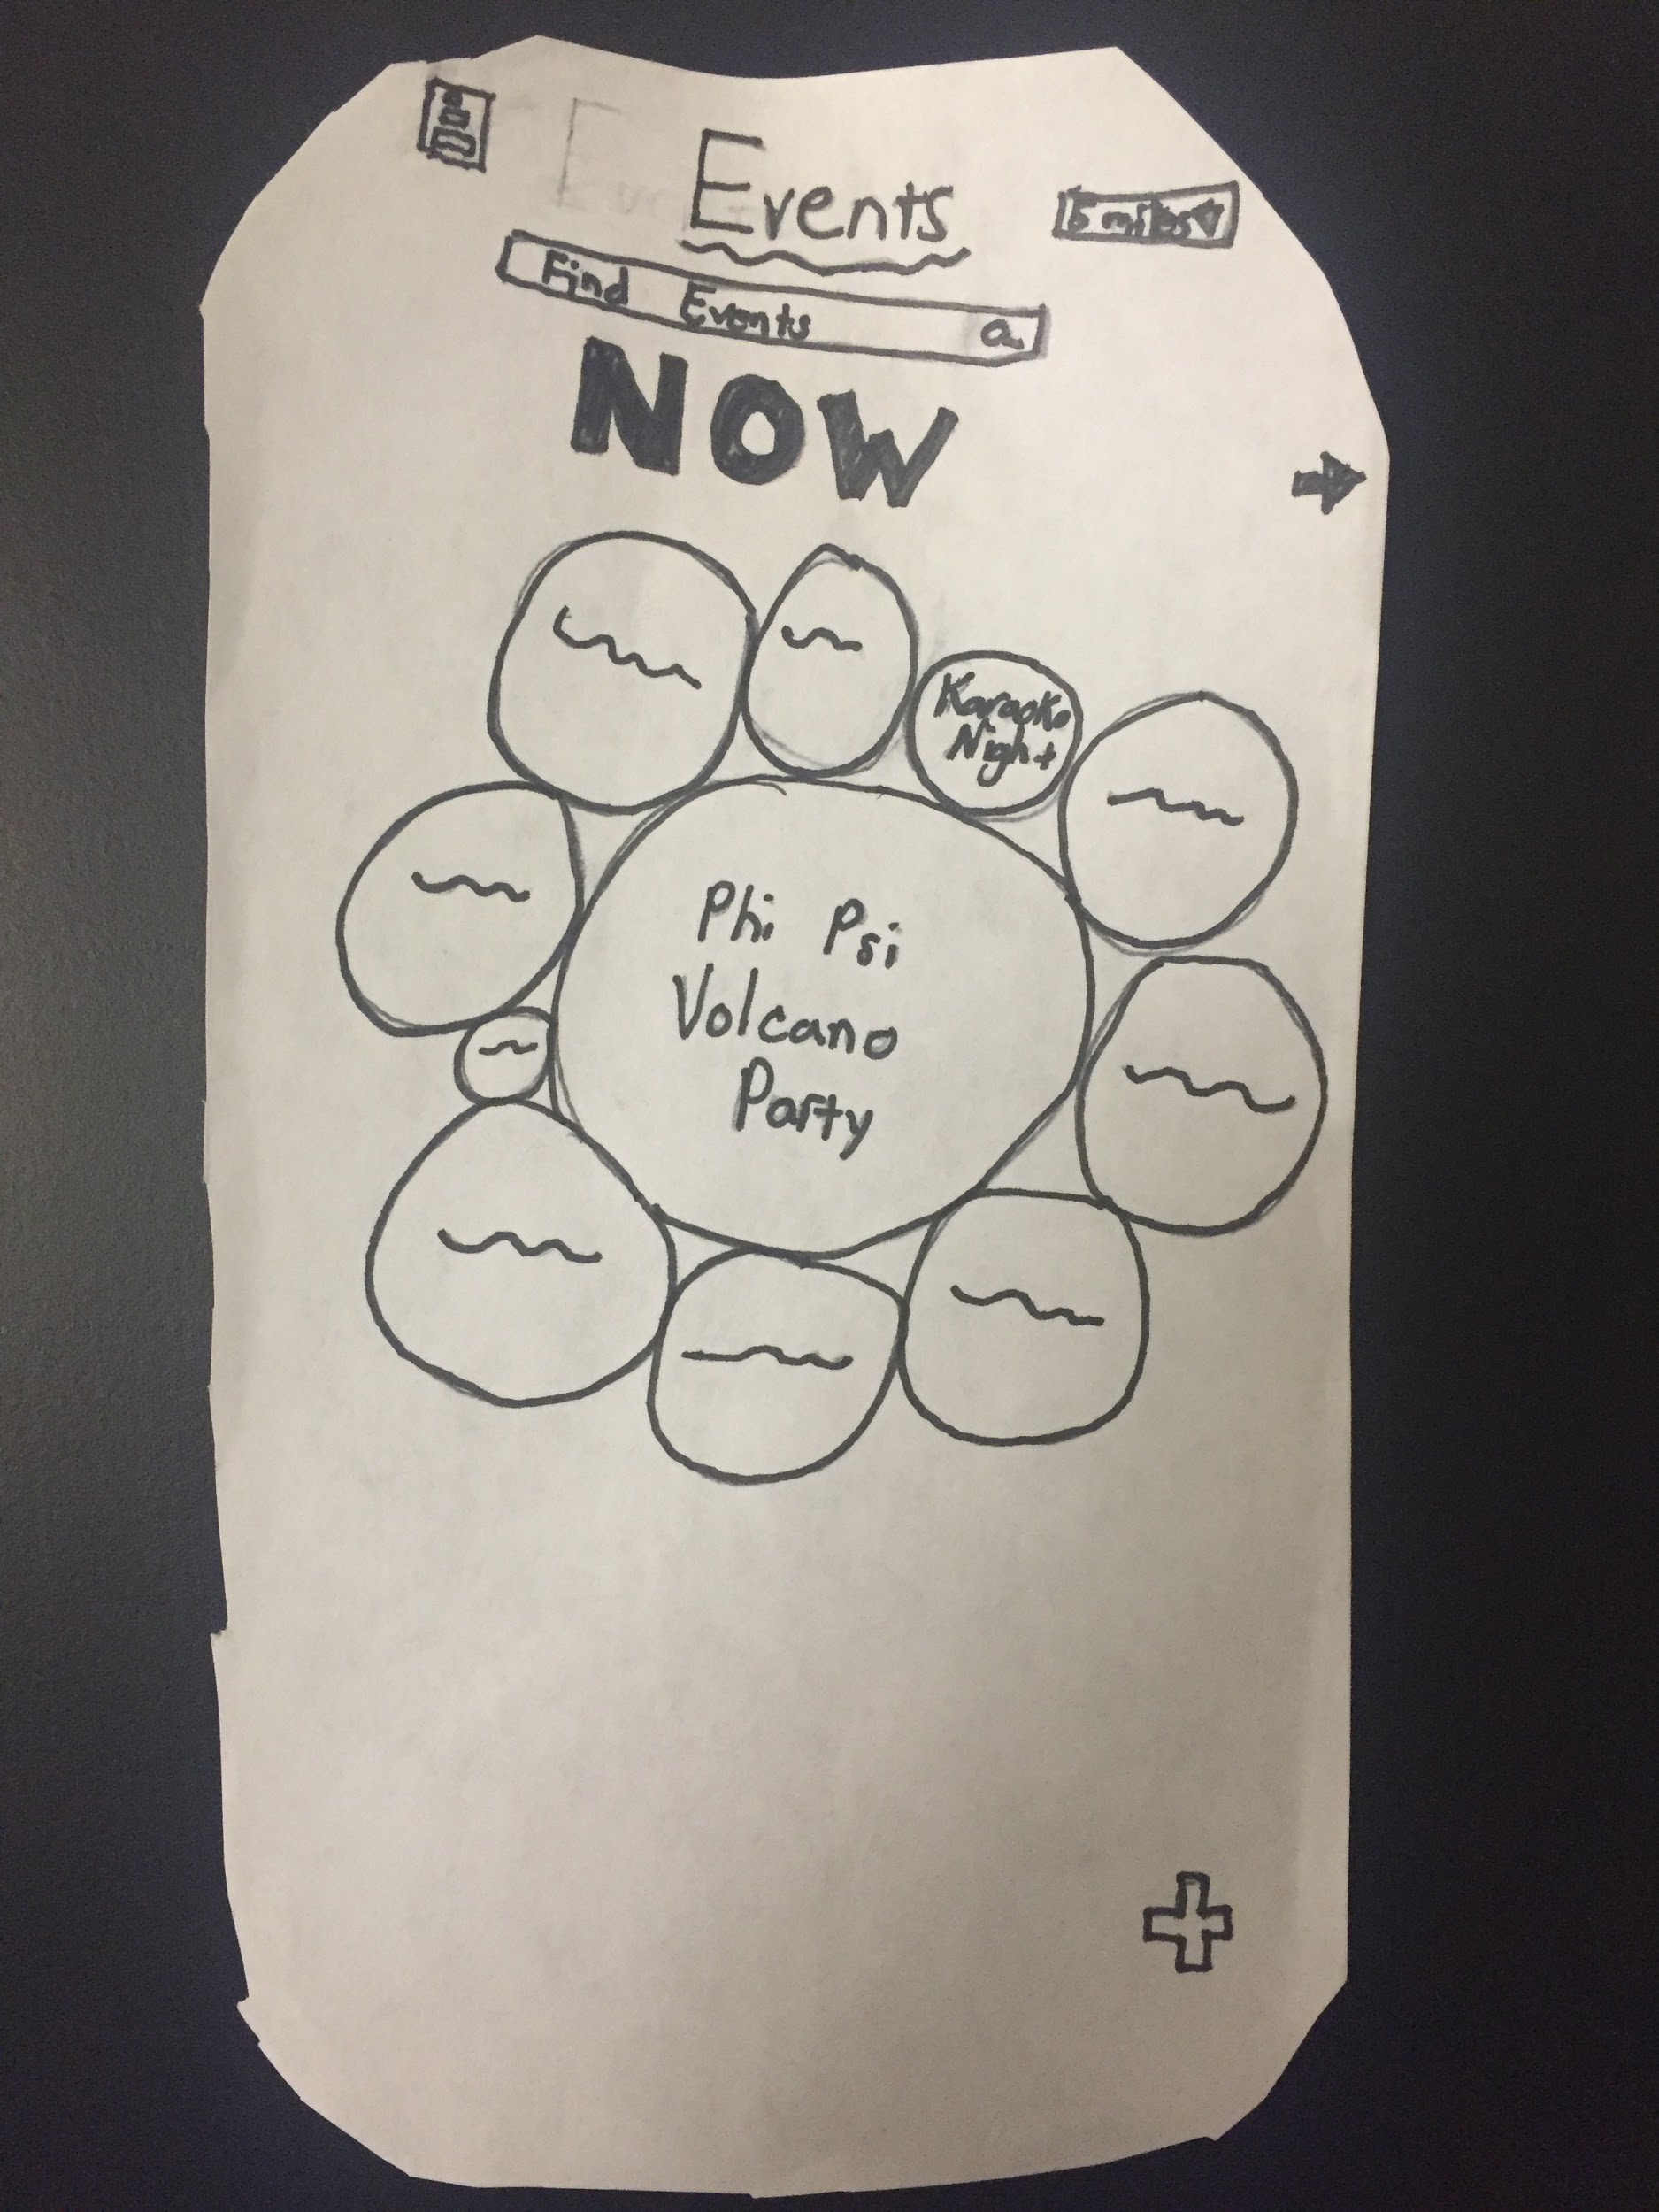
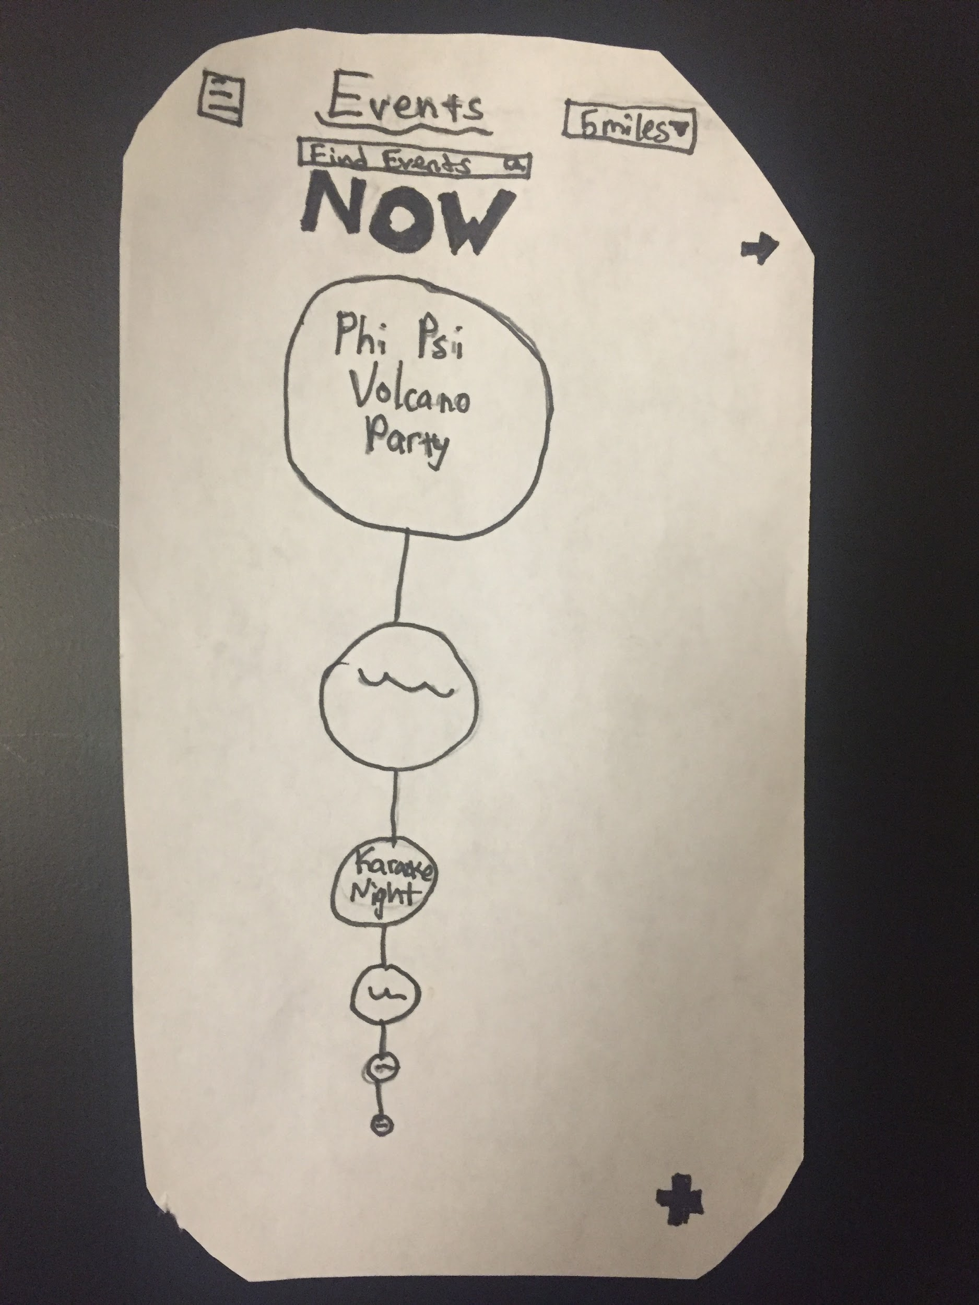
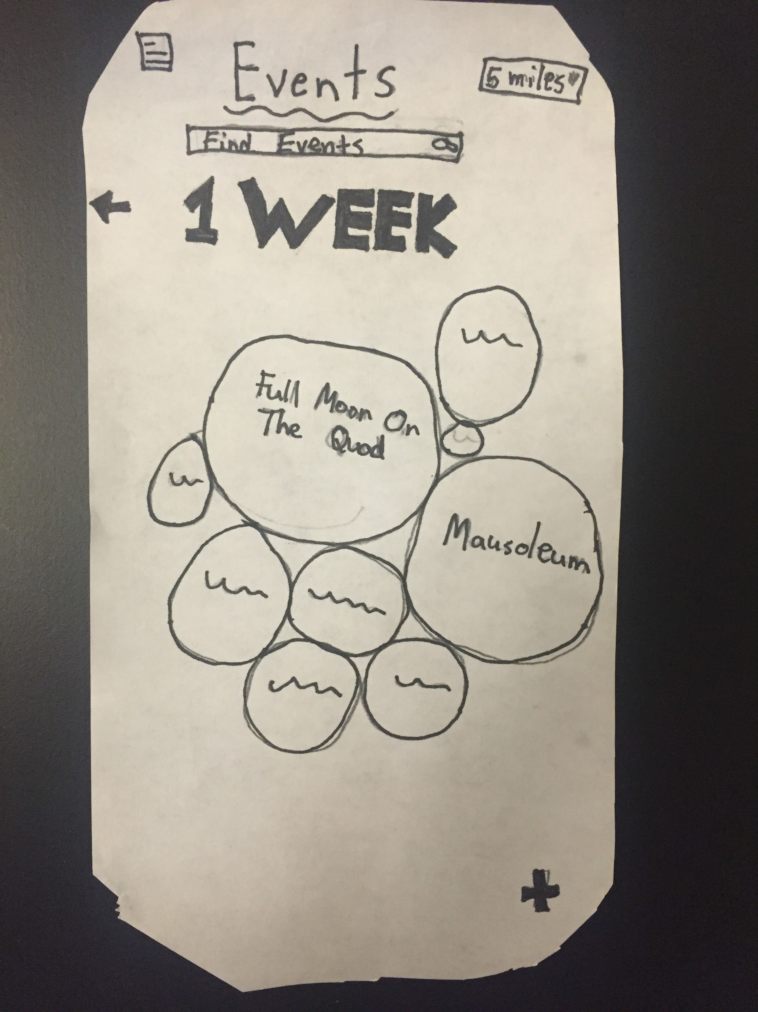
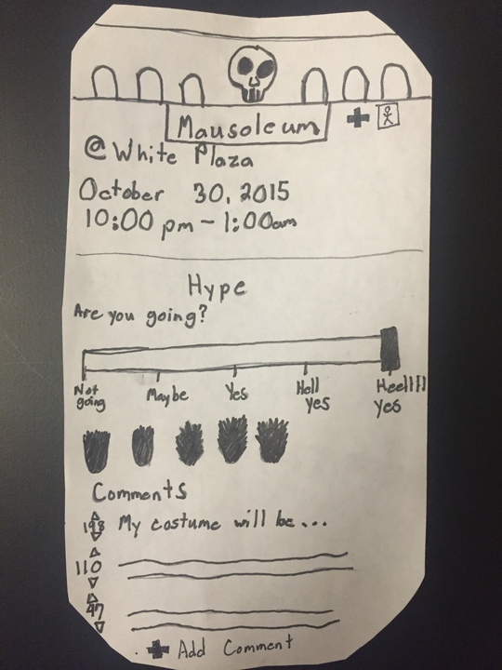
Task 1: Find Events
Default View
Sorted View
Future View
Event View

Slide 7
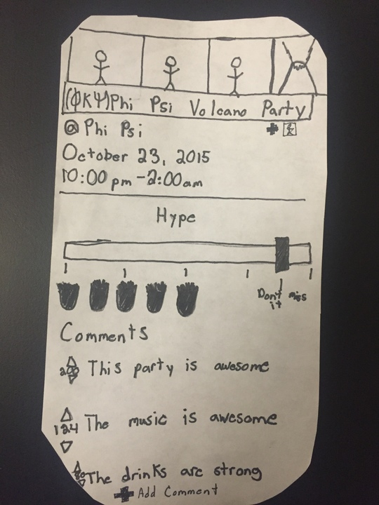
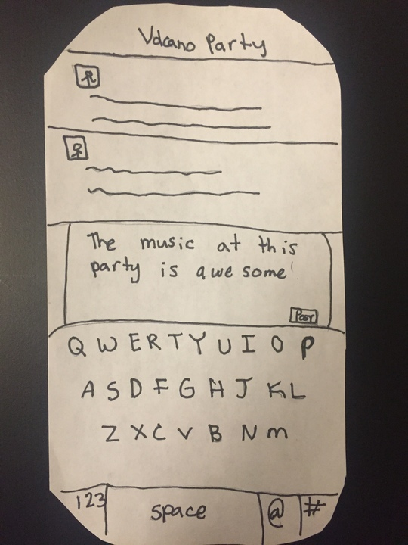
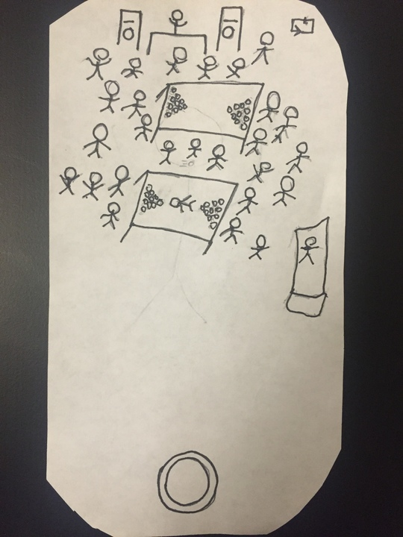
Task 2: Share about events
Back To
Event View
Event View
Comment View
Photo Sharing View

Slide 8
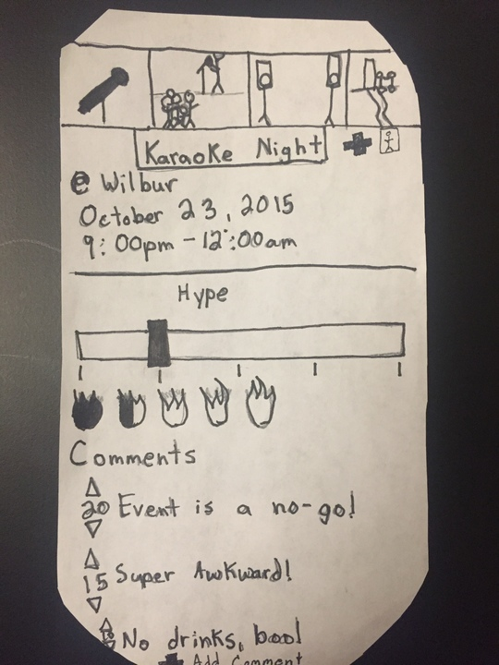
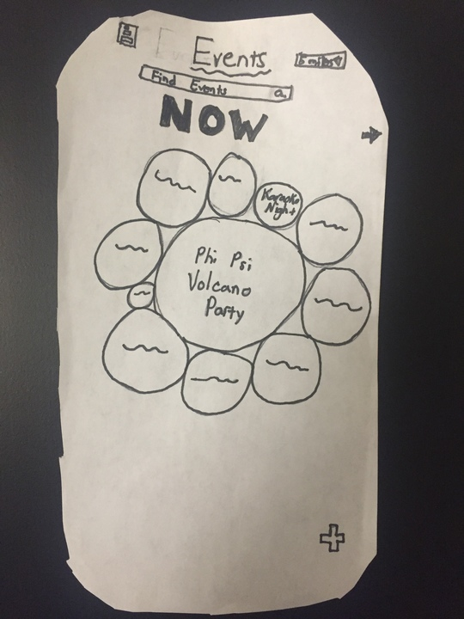
Task 3: Informed decision on event
Event View 1
Default View
Path 1
Event View 2
Path 2

Slide 9
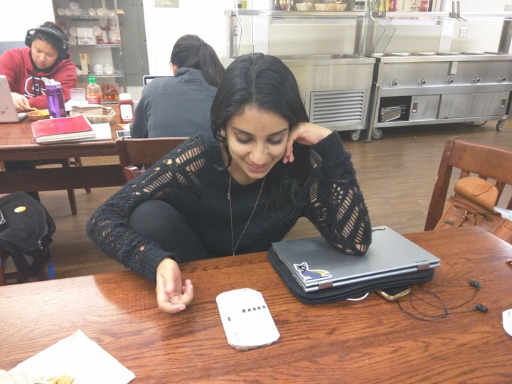
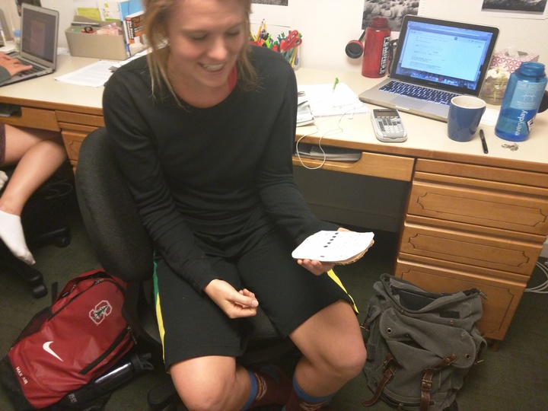
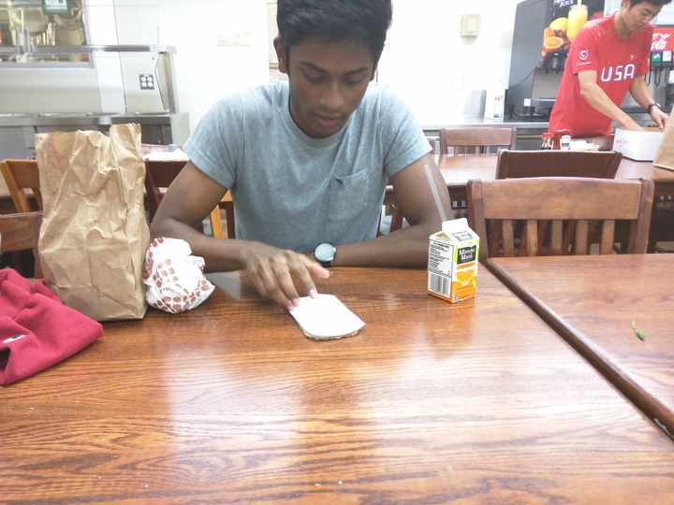

Experimental method
Experiment Subjects
Questions/Observations
Screen Shots
Instructions
Scribe
Phone (Computer)
Interviewer

Slide 10
Experimental results 1: Anika
Familiar User
Unclear labels (distance)
Photo posting option.

Slide 11
Experimental results 2: Rebecca
Unfamiliar w/ social apps
Difficult navigation
Cluttered information

Slide 12
Experimental results 3: Ajay
“Expert”
RSVP would be neat
Confused by slide bar
Instructional splash screen

Slide 13
Suggested UI changes
Stripped down/intuitive info
RSVP button/option
Intuitive Navigation

Slide 14
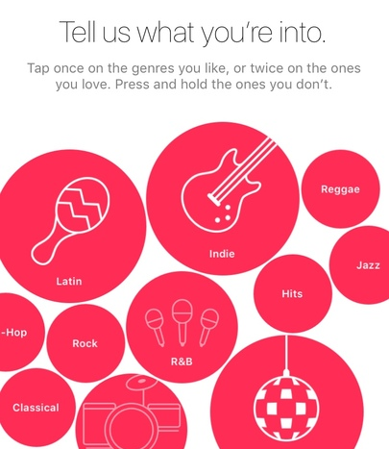
Summary
Why we chose our interface
2. Prototyping
3. Improvements

